Slide 1

Tolani polytechnic college
BRANCH :- DIPLOMA ELECTRICAL
ENGINEERING
SEMESTER:- 5TH
BATCH :- 1
TOPIC :- GENERATIOIN OF ELECTRICITY
FROM NOISE POLLUTION
MADE BY:
AJIT KULKARNI : 196510309005
AYUSH SRIVASTAVA : 196510309011
ARJUN CHANGLA : 196510309013
HARSHVARDHAN GADHVI : 196510309019
GUIDED BY: NIMESH PRAJAPATI SIR

Slide 2
components
speaker
transformers
Led Light
&
LDR
SWITCHES
OR
ARDUINO
PCB
&
CARDBOARD
CONNECTING WIIRES

Slide 3
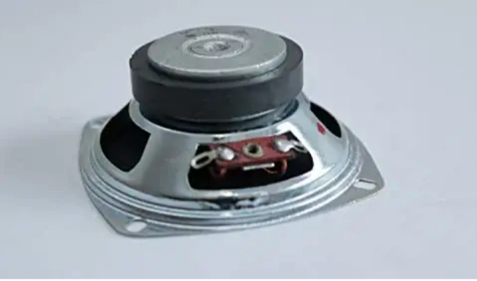
COMPONENTS
ABSORBING SPEAKER
1 ) THIS IS THE MAIN COMPONENT OF THE PROJECT.SPEAKER IS USE TO ABSORB THE SURROUNDING SOUND.
2) SPEAKER SIZE :- 3 INCH
3)- SPEAKER PRICE :- 90 RS 1 UNIT
4) REQUIRED SPEAKER :- 5 UNIT

Slide 4
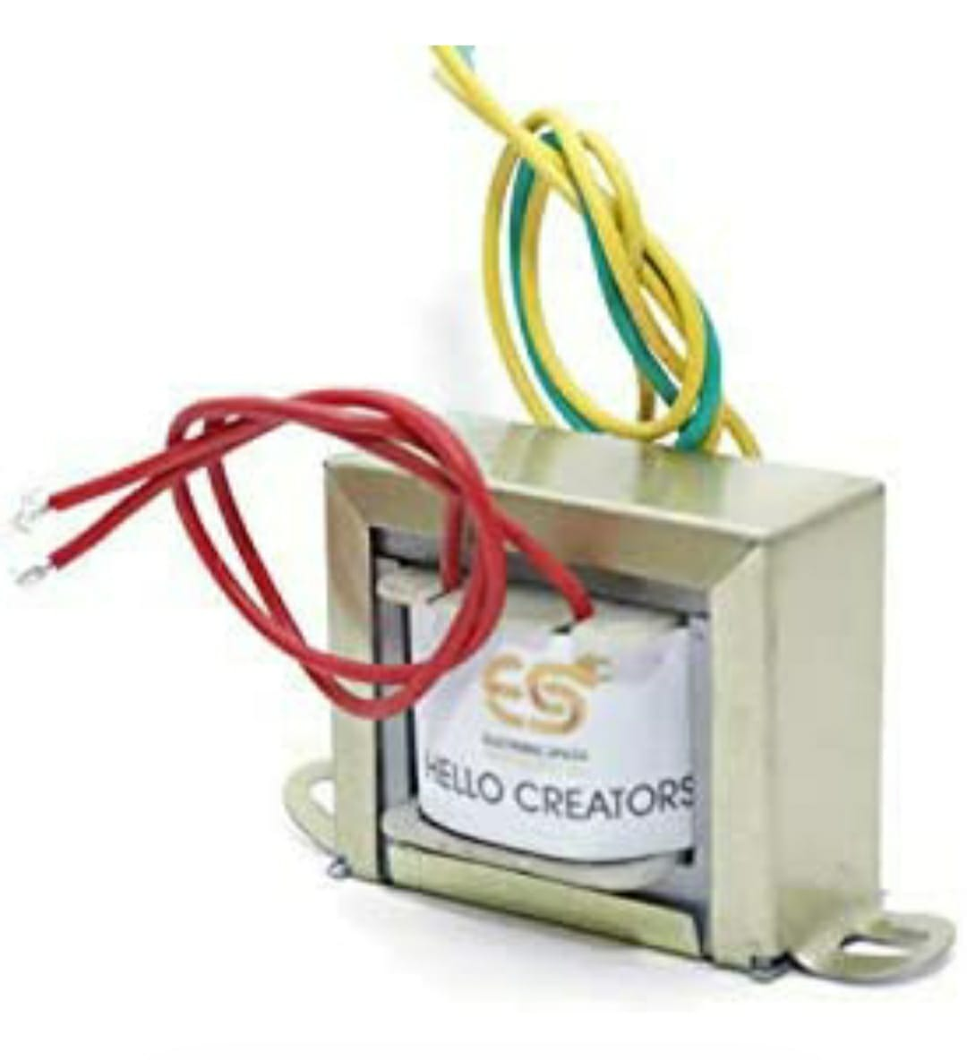
STEP-UP SIGNAL TRANSFORMER
THE MAIN WORK OF TRANSFORMER IS TO INCERASE THE LEVEL OF SIGNAL COMING FROM THE SPEAKERS.
(LOW SIGNAL ---- HIGH SIGNAL)
TRANSFORMERS RANGE– 12V TO 22OV
TRANSFORMERS PRICE – 100 – 1 UNIT
REQUIRED TRANSFORMER – 2 UNIT

Slide 5
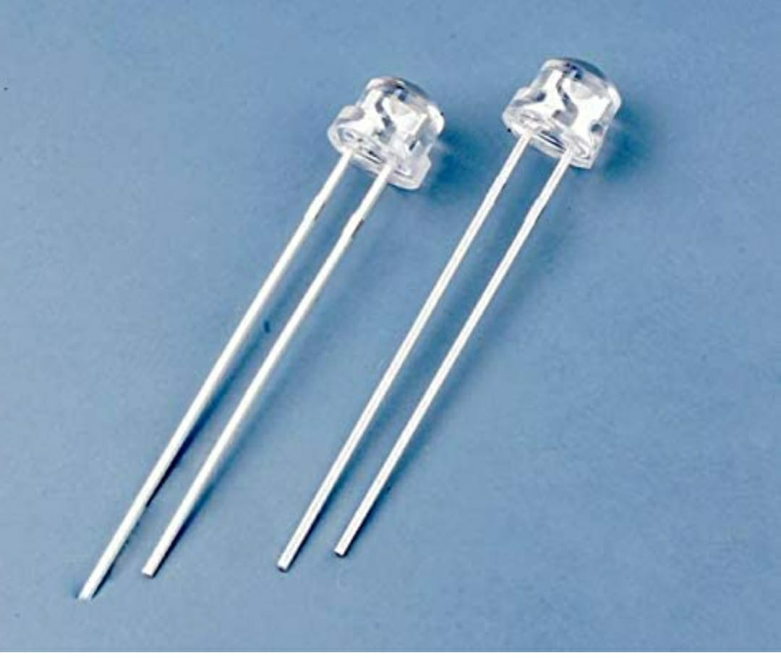
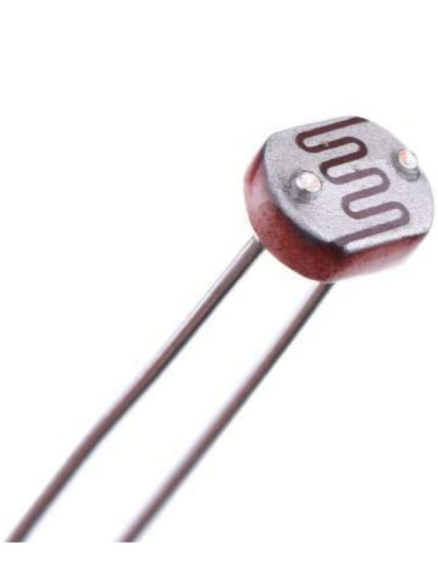
LED & LDR
(LIGHT EMITTING DIODE) = LED IS USED IN STREET LIGHT AND BUILDING , ETC.
LIGHT DEPENDENT RESISTOR. IT IS A PASSIVE COMPONENT THAT DECREASES RESISTANCE WITH RESPECT TO RECIVING LUMINOSITY(LIGHT) ON THE COMPONENTS SENSITIVE SURFACE.
PRICE – 30RS – 1 UNIT

Slide 6
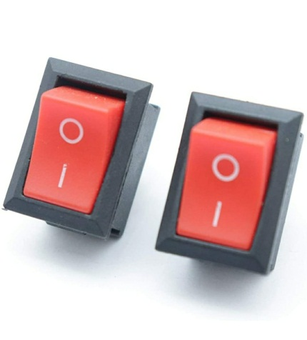
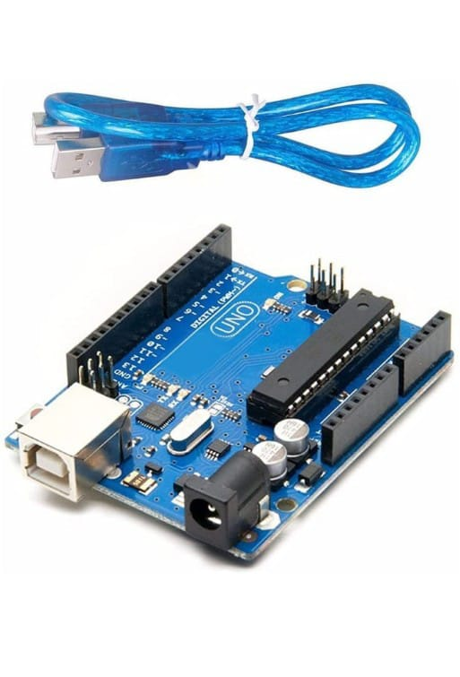
SWITCHES & AURDINO
SWITCHES:- IT IS USED TO ON/OFF
AURDINO:- IT IS A CIRCUIT CONTROLLER DEVICE WHICH IS USED IN OPEN SOURCE . SO HARDWARE And software company , project which are used to design ND MANUFACTURE SINGLE BOARD MICROCONTROLLERS TO MAKE DIGITAL DEVICES
PRICE – 800
REQUIRED -- 1

Slide 7
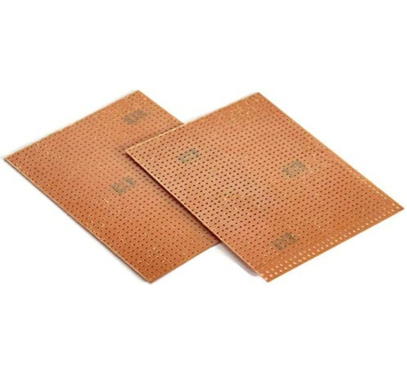
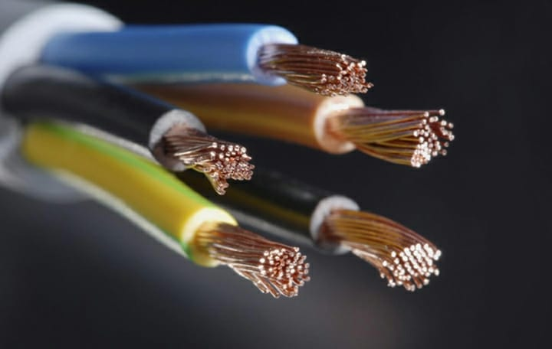
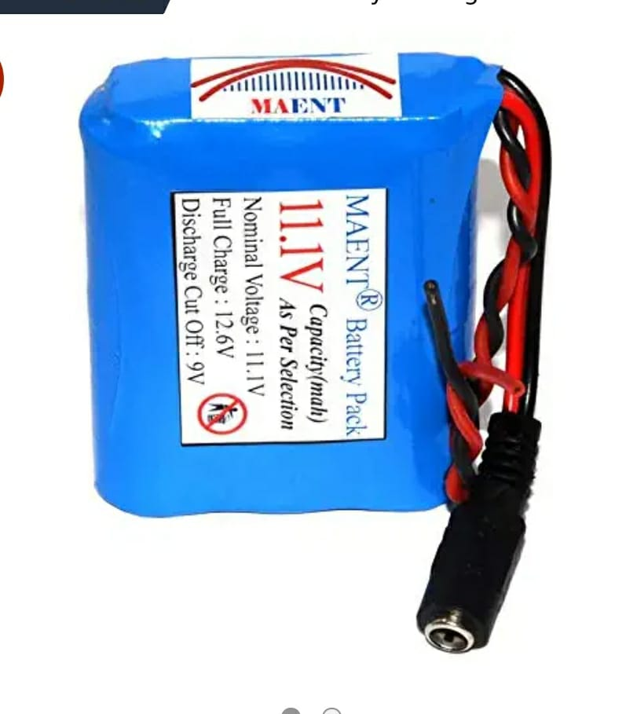
PCB , CONNECTING WIRES &
BATTERY
*PCB:- PRINTED CIRCUIT BOARD.PCB IS USE BOTH FOR BORE AND ASSEMBLED BOARDS .
PRICE– 69RS
*CONNECTING WIRES :- WIRES ARE USED TO CONNECT THE EQUIPMENT FROM EACH OTHER (LUMP SUM).
*BATTERY :- IT IS USED TO BE STORE THE POWER GENERATED FROM THE SPEAKER.
PRICE:- 500RS
REQUIRED:- 1

Slide 8
principle
The conversion of sound energy into
electrical energy.
when the sound energy (signals) are absorbed by absorbing speaker.
and then the soft layer of diaphragm on the upper side get vibrate.
by this vibration the moving coil in it also vibrate .

Slide 9
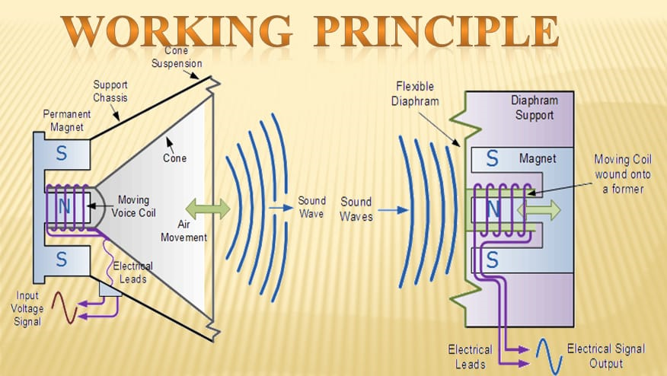
AND WITH THE HELP OF FIELD MAGNET THE VIBRATION CUTS THE FIELD FLUX LINE .
AND THE ELECTRICAL SIGNAL ARE PRODUCED .
THESE ELECTRIC SIGNAL ARE STEP – UP AND CAN BE USED AS ELECTRICAL ENERGY.

Slide 10
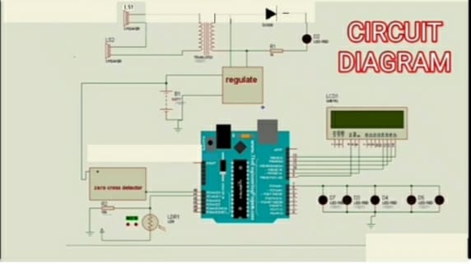

Slide 11
DECIBEL CHART OF DIFFERENT AREAS

Slide 12
USES
NOTE: AS PER WE KNOW THAT THE POTENTIAL OF ENERGY PRODUCED BY SOUND IS A BIT LESS THAN OTHER SOURCES OF ENERGY . HENCE , WE HAVE TO MAKE THE USE OF THIS ENERGY AS PER NEARBY LOCATIOIN. SO WITH THAT WE CAN REDUCE THE LOSSES IN TRANSMISSION AND ITS EFFICIENCY WILL INCREASE.

Slide 13
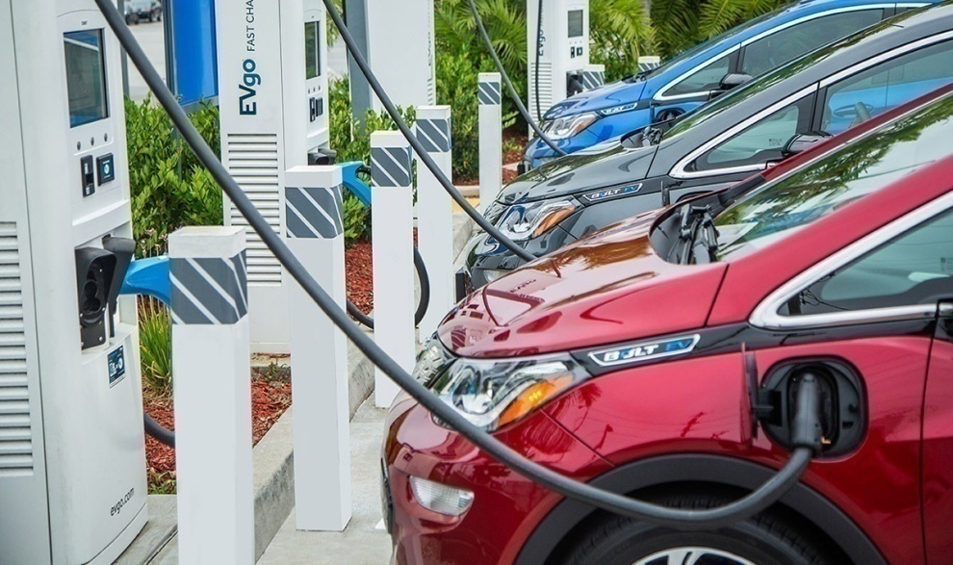
1) ELECTRIC CAR CHARGING
AS CHARGING STATION ARE NEARER TO ROADS SO THE ENERGY PRODUCED BY SOUND IS TRANSMITED TO THE STATION AND MAKE THE USE OF THIS.FROM OUR RESEARCH WE HAVE FOUND THAT THE ROAD BETWEEN DELHI TO CHANDIGARH HAS BECOME THE FIRST ELECTRIC ROAD AND IN FUTURE IT WILL INCREASE THE ELECTRIC CRISIS IN INDIA . SO WITH THIS SOUCRE WE CAN OVERCOME THE SITUATION.

Slide 14
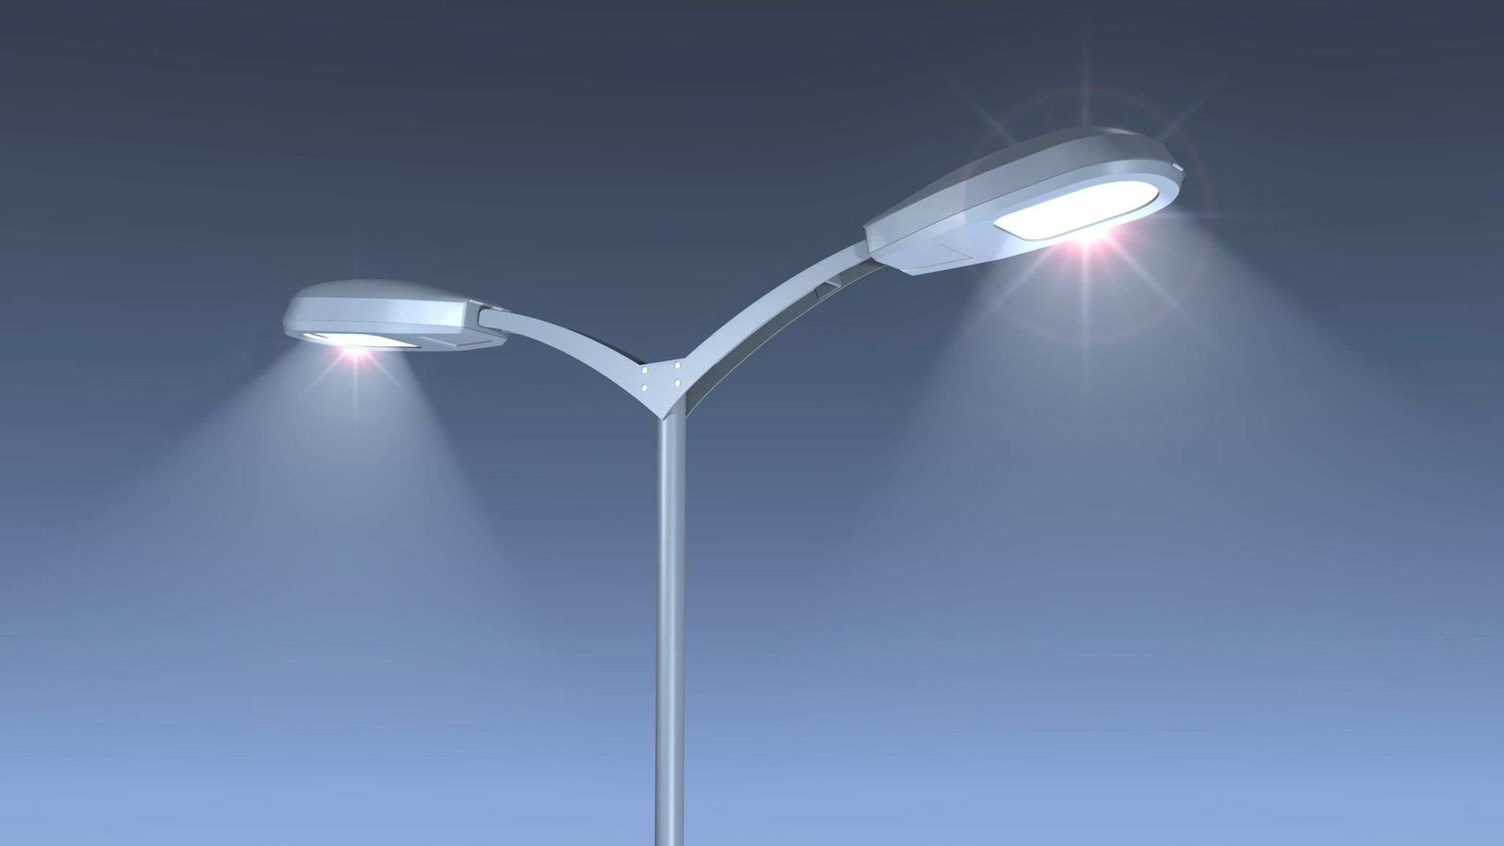
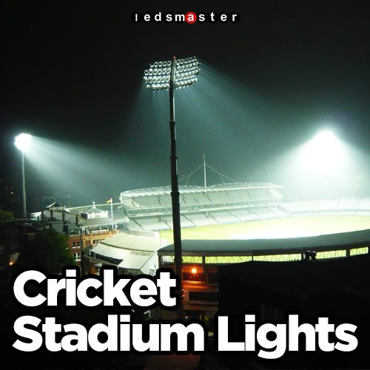
2) STREET LIGHTS 3) CRICKET STADUIM
LIGHTS
THIS ELECTRICAL ENERGY IS USED TO GLOW THE STREET LIGHTS AND CRICKET STADIUM LIGHTS. AND ANY OTHER PLACES WHERE DECORATIVE LIGHTS ARE REQUIRED.
4) STANDBY UNIT
IT CAN ALSO BE USED IN SEVERAL POWER PLANTS AND IN EMERGENCY SITUITION

